Slide 1


EPLISON 4.0
CROSS - HACK

Slide 2

Problem Statement
Due to heightened competition from the Virtual Reality (VR) sector, Prime-Time Entertainment, a well-known maker of video games, has seen its income fall. In order to restore market share and increase income, they are a client of Epsilon Analytics and are looking for advice on how to invest in the developing VR sector. The task is to assess the market potential for VR gaming in North America, Europe, and Japan and to offer tactical suggestions and advice to Prime-Time Entertainment for a successful entry into this quickly expanding industry.

Slide 3
IDENTIFICATION OF KEY PARAMETERS WHICH DRIVES THE GROWTH OF A
VIDEO GAME
Viewership of the Game.
The game is offline or Online.
The game is Multiplayer or SinglePlayer.
The genre of the Game. (Shotting, Racing, etc.)
Rating for the Game.
User Score & Critic Score of the Game.
Download Size & Price of the Game.
The platform for the Game.

Slide 4
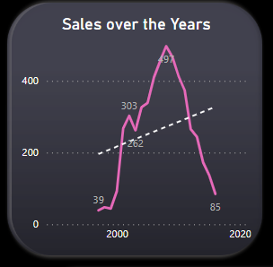
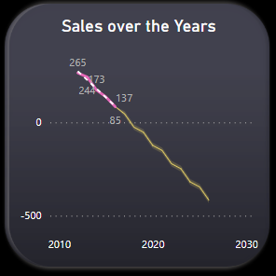
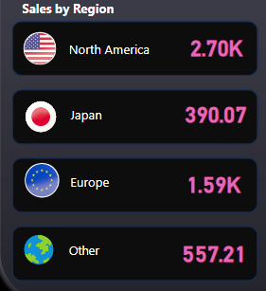
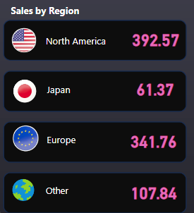
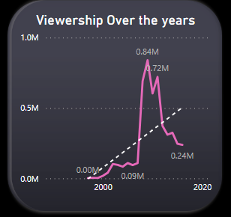
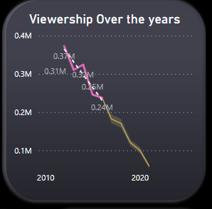
PERFORM A TREND ANALYSIS SHOWING HOW THE VIDEO GAME INDUSTRY
HAS EVOLVED OVER THE COURSE OF TIME.
Over the Years
Last 5 Years
Over the Years
Last 5 Years

Slide 5
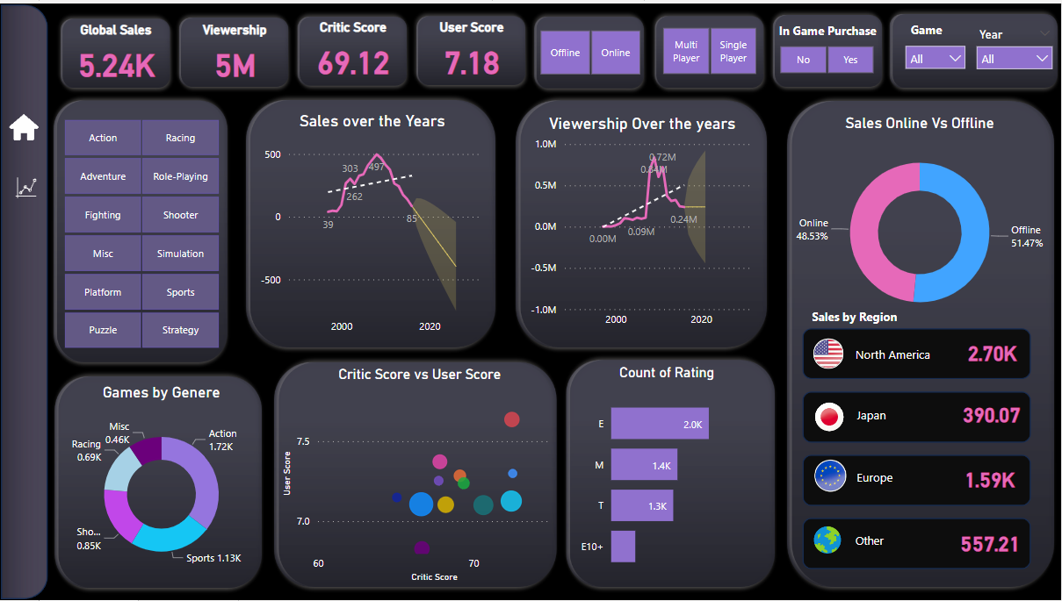
Derive key insights from the data and create an overall summary of the same which could be explained easily, preferably in the form of a dashboard.
Page 1

Slide 6
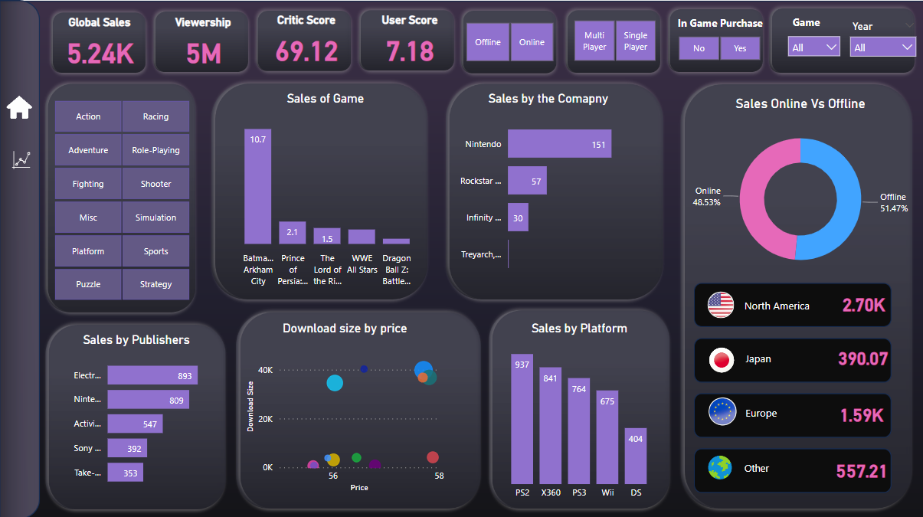
Page 2

Slide 7
Key parameters to keep in mind while developing the game
Shotter, Sports are the two Genre with the highest user & Critic scores and the highest sales.
Online Games perform better in sales than offline games.
Games with Rating M have the highest sales.
Multiplayer Games have the highest sales and viewership.
The top platforms for the above criteria are PS4, X360 and XOne.
Electronic Arts, Activision and Take-Two Interactive are the top Publishers.
The average Download size for Sports is 52382 and for Shotter 50455.
EA Dice, Massive Entertainment and Creative Assembly are the top Companies.
Note: As you move below in the above points it inherits the above or as moving below acting as a filter.

Slide 8
THANK
YOU

